Slide 1
Capstone Project by Ifeoluwa A.
March 2024

Slide 2
Expectations and problem statement:
We want to evaluate the relationship between the different variables and customer churn
We also want to recommend what we think the organisation needs to do based on the findings

Slide 3
Data features
customerID’, 'gender’, 'SeniorCitizen’, 'Partner’, 'Dependents’, 'tenure’, 'PhoneService’,
'MultipleLines’, 'InternetService', 'OnlineSecurity', 'OnlineBackup', 'DeviceProtection’,
'TechSupport’, 'StreamingTV', 'StreamingMovies', 'Contract', 'PaperlessBilling’,
'PaymentMethod', 'MonthlyCharges', 'TotalCharges', 'Churn’

Slide 4
Observations on the data, and the data cleaning process:
We observe that the data is made up of predominantly categorical data, and there is need to convert it to numerical data for easy analysis using Python. With a total of 21 features, we have 4 features with numerical data and 17 features with categorical data.
We have a total of 7,043 entries for each feature. I used the heatmap to visualise the missing data and assess the impact on the analysis, the colour consistency throughout the map indicates that is negligible. However, I have decided to remove the rows with missing values for easier analysis. I delete them because the missing values are not significant in number. We are left with a total of 7,032 entries for each feature, and this is sufficient for the analysis.
There are no duplicate values.

Slide 5
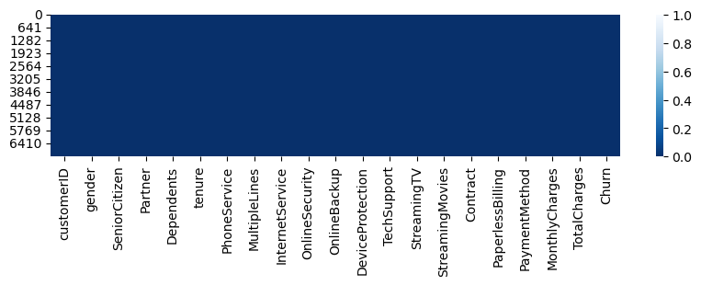
Visualising the Missing variables

Slide 6
Observations on the univariate data analysis and general statistics
I observe, through the boxplot, the absence of outliers when looking at the length of the tenure of customers and it is positively skewed.
I also observe, through the boxplot, the absence of outliers when looking at the monthly payment of customers and it is negatively skewed.

Slide 7
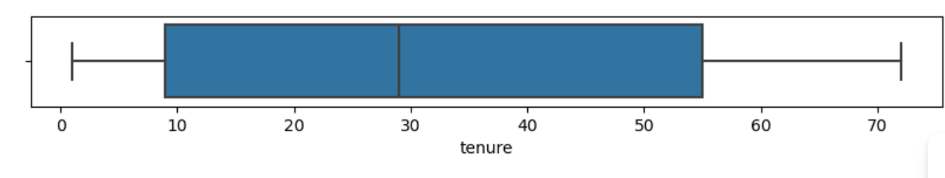
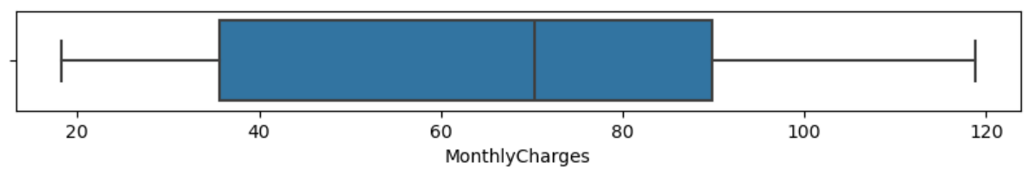

Slide 8
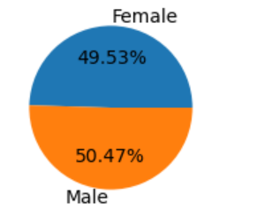
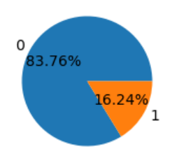
About 16.24% of the users are senior citizens, while 83.76% are not. It is represented in the pie chart.
The number of male and female customers are very close: 49.53% of customers are female, and 50.47% of customers are male. It is represented in the pie chart.

Slide 9
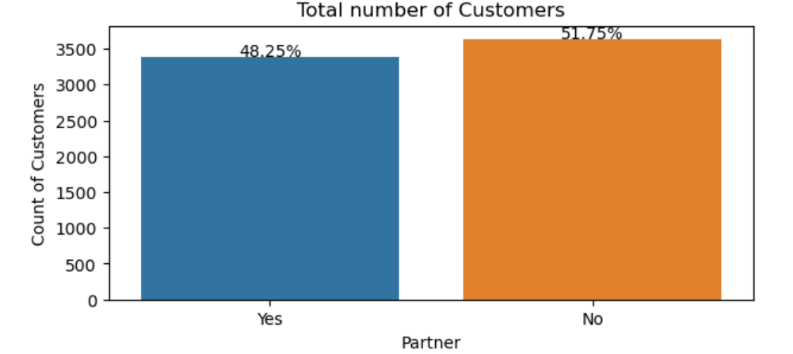
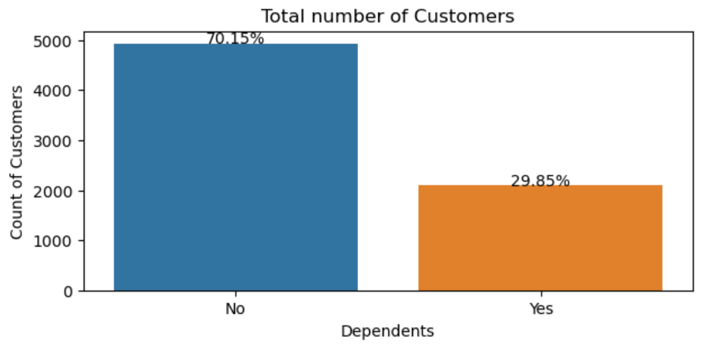
About 70.15% of customers do not have dependents, while 29.85% of customers have dependents. It is represented in the bar chart.
The number of customers with partners and those without are quite close, with 51.75% of customers without partners and 48.25% with partners. It is represented in the bar chart.

Slide 10
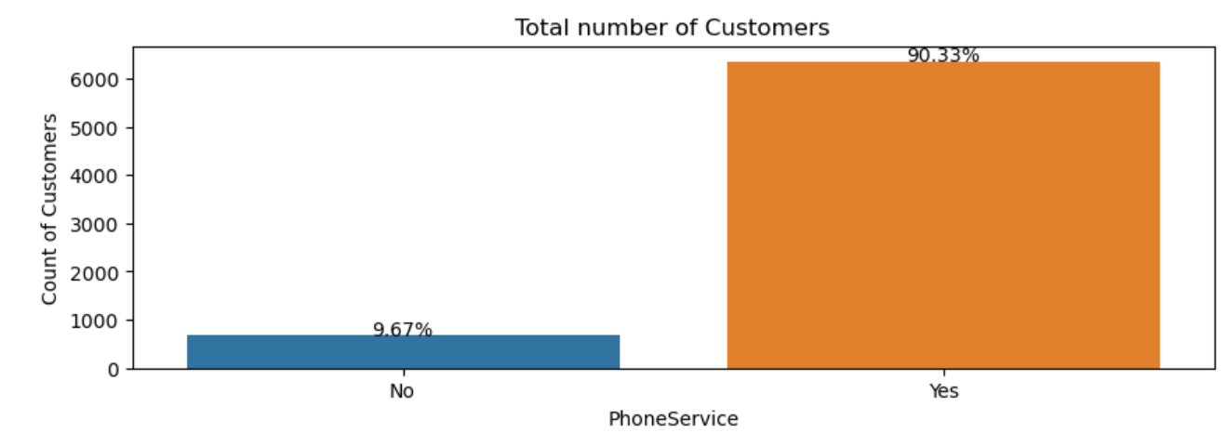
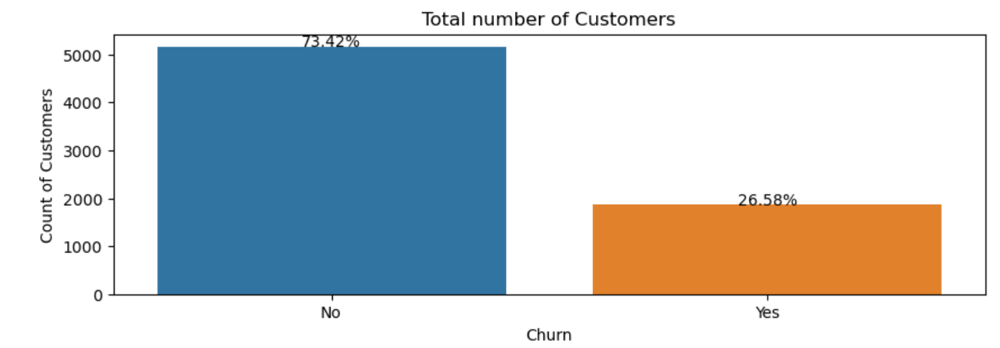
90.33% of customers have a phone service, while 9.67% of customers don't. It is represented in the bar chart.
73.42% of customers have not churned, while 26.58% of customers have churned. It is represented in the bar chart.

Slide 11
Observations on the bi-variate data analysis:
We can observe from the combined count-plots that the churn number of both male and female are very similar.
It also shows that those with month-to-month contract, and those who used the fibre optic internet service had higher numbers of customers who churned.
Customers without online security, without online backup, without device protection and without tech support had relatively higher churn numbers.
Those who used electronic check as a payment method had significantly high numbers of customers who churned as against those who stayed with the network (the highest churn rate so far), when compared with those who used other methods of payment.

Slide 12
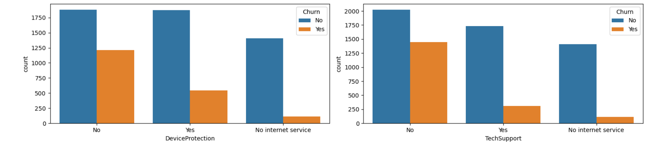
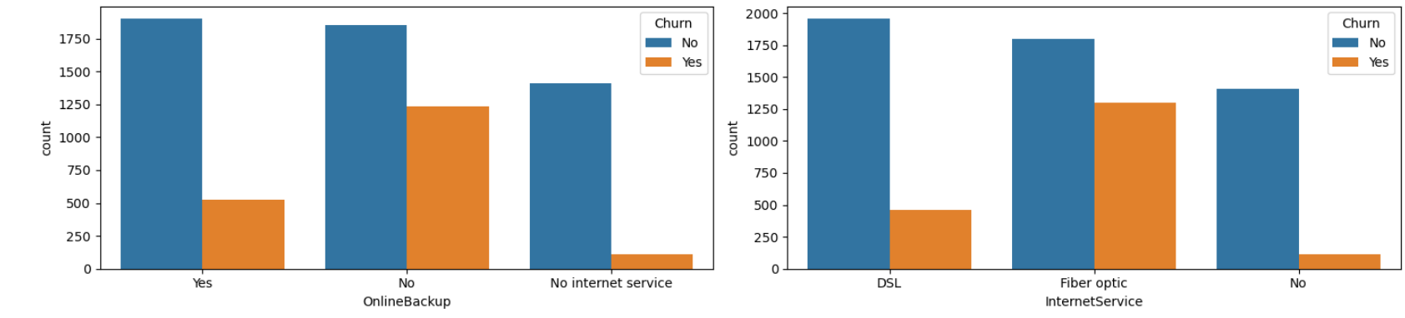

Slide 13
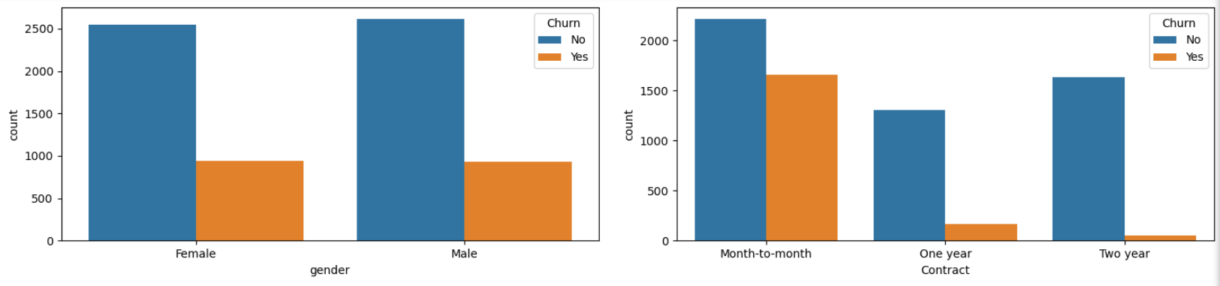
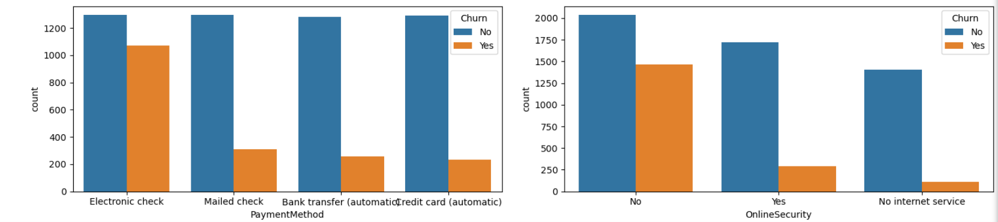

Slide 14
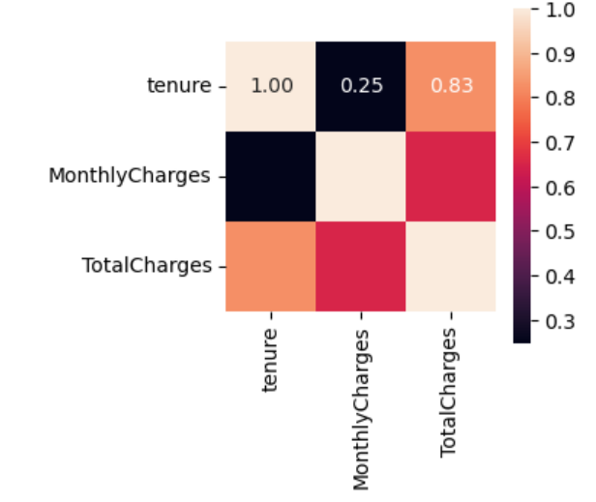
Observations on the multivariate data analysis
We observe from the correlation analysis, showing a correlation value of 0.25, that there is a weak positive relationship between the tenure (how long a customer stays) and the monthly charges.
We however observe that there is a strong positive relationship, with a correlation value of 0.83, between the tenure (how long a customer stays) and the overall charges.

Slide 15
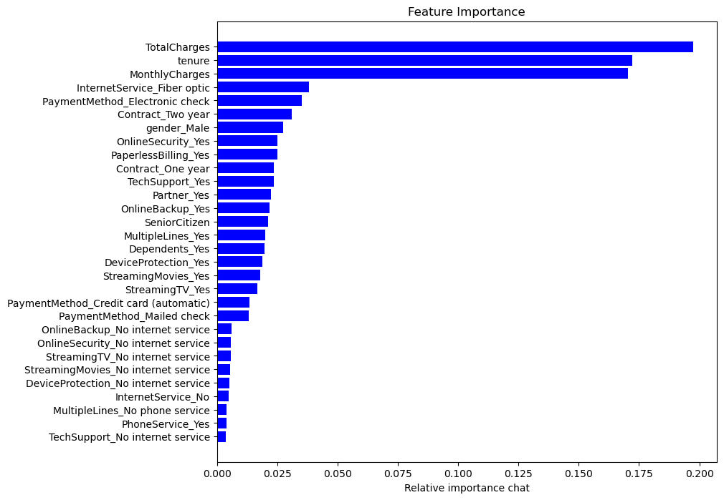
Feature Importance
Monthly charges, total charges and tenure seem to have a strong relationship with the churn

Slide 16
Feature selection:
I carried out the following data preprocessing steps: created a copy of the data; dropped off some redundant features; encoded the categorical data; segmented the dataset into data and target label-with the target here as 'Churn'; normalised and scaled the data using MinMaxScaler; and carried out a feature importance score for feature selection.
Based on insights from my EDA, and the Importances chart, I select the following features to test/train the model: contract, internet service, online security, online backup, device protection, tech support, payment method, including the top 10 in the feature Importance chart.

Slide 17
Model selection:
The target data, 'Churn', is a categorical data and has a discrete class label. Therefore, I have chosen 3 classification models that are better suited for when the target data is categorical and has a discrete class label.
I used three supervised learning models: Decision Tree Classification, Support Vector Classification (SVC), XGBClassifier.
I imported relevant libraries.
Model training and evaluation:
I imported relevant libraries for model training
I carried out the train, test and evaluation

Slide 18
Target Data Definition:
The target variable is "Churn". The target variable indicates whether the customer has churned (canceled the service) or not.
Where "True" is indicated, it implies "Yes". This can be interpreted as True = Yes = The customer has churned = the customer has left the service.
Where "False" is indicated, it implies "No". This can be interpreted as False = No = The customer has not churned = the customer has not left the service
True = 1 = positive
False = 0 = negative
Our objective is to predict whether the customer will leave or stay.

Slide 19
Interpretation of Decision Tree Classifier:
Accuracy: 72.71%, indicates that about 72.71% of the predictions made by the model are correct.
Precision: 48.65%, indicates that about 48.66% of the predictions of Churns made by the model are correct.
Recall: 48.40%, indicates that the model correctly predicts about 48.40% of the churns.
F1-score: 48.53%, indicates that the model has poor precision and recall, and cannot concurrently attain high precision and recall.
ROC-AUC Score: 64.95%, indicates that the models performance is fair, and can make predictions better than chance, and better than a random guess.
Classification report:
81% of the retentions were correctly predicted as retentions.
49% of the churns were correctly predicted as churns.
82% of all retentions were correctly identified by the model.
48% of all churns were correctly identified by the model.
73% of the overall model is accurate.
F1-score: 81% for retentions, 49% for churns.
Confusion matrix:
847 instances were correctly predicted as churn.
186 instances were incorrectly predicted as churn.
186 instances were incorrectly predicted as retention.
168 instances were correctly predicted as retention.

Slide 20
Interpretation of Support Vector Classification (SVC):
Accuracy: 77.61%, indicates that about 77.61% of the predictions made by the model are correct.
Precision: 60.65%, indicates that about 60.65% of the predictions of Churns made by the model are correct.
Recall: 44.92%, indicates that the model correctly predicts about 44.92% of the churns.
F1-score: 51.61%, indicates that the model achieves a reasonable trade-off between minimizing false Churn, and false retention predictions.
ROC-AUC Score: 67.18%, indicates that the models performance is fair, and can make predictions better than chance, and better than a random guess.
Classification report:
82% of the retentions were correctly predicted as retentions.
61% of the churns were correctly predicted as churns.
89% of all retentions were correctly identified by the model.
45% of all churns were correctly identified by the model.
78% of the overall model is accurate.
F1-score: 85% for retentions, 52% for churns.
Confusion matrix:
924 instances were correctly predicted as churn.
109 instances were incorrectly predicted as churn.
206 instances were incorrectly predicted as retention.
168 instances were correctly predicted as retention.

Slide 21
Interpretation of XGBoost Classifier:
Accuracy: 77.83%, indicates that about 77.83% of the predictions made by the model are correct.
Precision: 59.87%, indicates that about 59.87% of the predictions of Churns made by the model are correct.
Recall: 50.27%, indicates that the model correctly predicts about 50.27% of the churns.
F1-score: 54.65%, indicates that the model achieves a reasonable trade-off between minimizing false Churn, and false retention predictions.
ROC-AUC Score: 69.03%, indicates that the models performance is fair, and can make predictions better than chance, and better than a random guess.
Classification report:
83% of the retentions were correctly predicted as retentions.
60% of the churns were correctly predicted as churns.
88% of all retentions were correctly identified by the model.
50% of all churns were correctly identified by the model.
78% of the overall model is accurate.
F1-score: 85% for retentions, 55% for churns.
Confusion matrix:
907 instances were correctly predicted as churn.
126 instances were incorrectly predicted as churn.
186 instances were incorrectly predicted as retention.
188 instances were correctly predicted as retention.

Slide 22
Recommendations:
The SVC or the XGBoost Classifiers are the best models to predict churns and retentions, based on the outcome of the evaluation.
I recommend that the business is concerned with both true positives and true negatives.
It is important for the business to know what churn numbers to expect in the future, and it is important to project the numbers of customers who will stay with the service. This will help to plan targeted campaigns.

